Slide 1
SCRIPT for DATA Cleaning

Slide 2
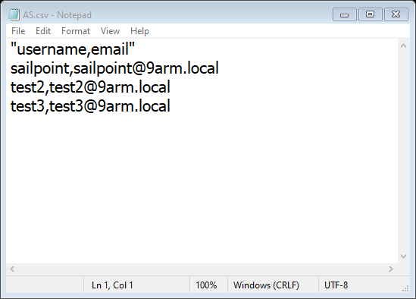
Authoritative Source to export username and email in to AS.csv file

Slide 3
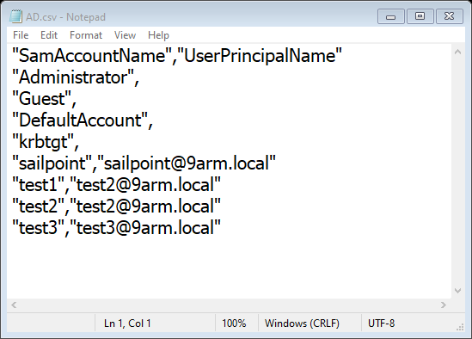
AD user to export with Powershell script on Active Directory server
Import-Module ActiveDirectory
# Specify the distinguished name (DN) of the "Engineer" OU
$ouDN = "OU=Engineer,DC=9arm,DC=local"
# Get users from the specified OU
Get-ADUser -Filter * -SearchBase $ouDN -Properties SamAccountName, UserPrincipalName |
Select-Object SamAccountName, UserPrincipalName |
Export-Csv -Path C:\Users\Administrator\Desktop\export\user.csv -NoTypeInformation
Notes:
Import-Module ActiveDirectory
# Specify the distinguished name (DN) of the "Engineer" OU
$ouDN = "OU=Engineer,DC=9arm,DC=local"
# Get users from the specified OU
Get-ADUser -Filter * -SearchBase $ouDN -Properties SamAccountName, UserPrincipalName |
Select-Object SamAccountName, UserPrincipalName |
Export-Csv -Path C:\Users\Administrator\Desktop\export\user.csv -NoTypeInformation

Slide 4
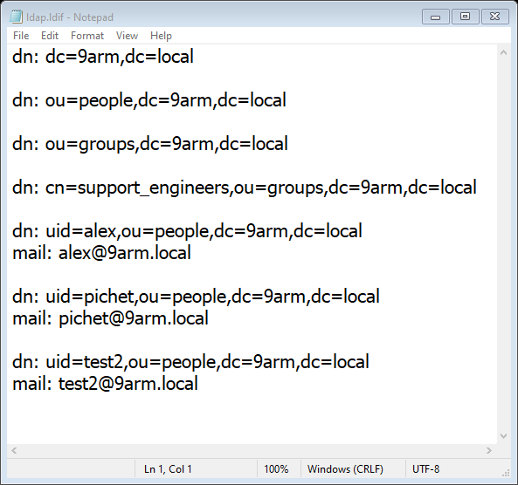
LDAP user to export with BASH script
ldapsearch -H ldap://ldap.m9arm.local:389 -x -LLL -b "ou=Engineer,dc=m9arm,dc=local" samaccountname mail userPrincipalName > ldap.ldif
Notes:
ldapsearch -H ldap://ldap.m9arm.local:389 -x -LLL -b dc=m9arm,dc=local samaccountname mail userPrincipalName > ldap.ldif
ldapsearch -H ldap://ldap.m9arm.local:389 -x -LLL -b "ou=Engineer,dc=m9arm,dc=local" samaccountname mail userPrincipalName > ldap.ldif

Slide 5
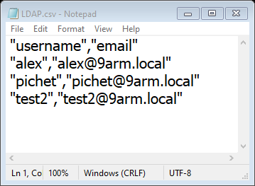
Convert ldif file to csv with username,email structure with powershell script
# Read the ldap.ldif file
$ldapData = Get-Content "ldap.ldif"
# Initialize an array to store user data
$userData = @()
# Iterate through the lines of the ldap.ldif file
for ($i = 0; $i -lt $ldapData.Count; $i++) {
# Check if the current line contains "uid" attribute
if ($ldapData[$i] -like "dn: uid=*") {
# Extract username from the "uid" attribute
$username = ($ldapData[$i] -split "=|,")[1]
# Extract email from the following line
$email = ($ldapData[$i+1] -split ": ")[1]
# Add the user data to the array
$userData += [PSCustomObject]@{
username = $username
email = $email
}
}
}
# Export the user data to LDAP.csv
$userData | Export-Csv -Path "LDAP.csv" -NoTypeInformation
Write-Host "LDAP.csv created successfully."
Notes:
# Read the ldap.ldif file
$ldapData = Get-Content "ldap.ldif"
# Initialize an array to store user data
$userData = @()
# Iterate through the lines of the ldap.ldif file
for ($i = 0; $i -lt $ldapData.Count; $i++) {
# Check if the current line contains "uid" attribute
if ($ldapData[$i] -like "dn: uid=*") {
# Extract username from the "uid" attribute
$username = ($ldapData[$i] -split "=|,")[1]
# Extract email from the following line
$email = ($ldapData[$i+1] -split ": ")[1]
# Add the user data to the array
$userData += [PSCustomObject]@{
username = $username
email = $email
}
}
}
# Export the user data to LDAP.csv
$userData | Export-Csv -Path "LDAP.csv" -NoTypeInformation
Write-Host "LDAP.csv created successfully."

Slide 6
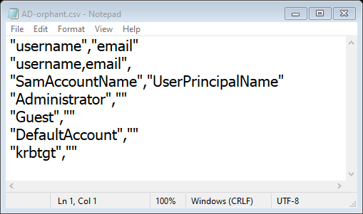
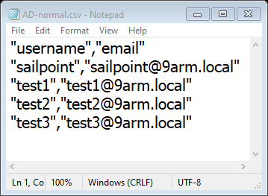
Compare Script will create 2 files 1 normal user 2 orphan user
# Import the CSV files with correct headers
$ASData = Import-Csv -Path 'AS.csv' -Header "username", "email"
$ADData = Import-Csv -Path 'AD.csv' -Header "SamAccountName", "UserPrincipalName"
# Create empty arrays to store the result sets
$normalUsers = @()
$orphantUsers = @()1
# Compare each user in AS.csv with users in AD.csv
foreach ($asUser in $ASData) {
$matchADUser = $ADData | Where-Object {
($_.SamAccountName -eq $asUser.username) -and ($_.UserPrincipalName -eq $asUser.email)
}
if ($matchADUser) {
# User match found, add to normal users list
$normalUsers += $asUser
} else {
# User not found in AD, add to orphan users list
$orphantUsers += $asUser
}
}
# Compare each user in AD.csv with users in AS.csv to find additional orphans
foreach ($adUser in $ADData) {
$matchASUser = $ASData | Where-Object {
($_.username -eq $adUser.SamAccountName) -and ($_.email -eq $adUser.UserPrincipalName)
}
if (!$matchASUser) {
# AD User not found in AS, add to orphan users list
# Convert AD user to an object with "username" and "email" properties
$orphanUser = [PSCustomObject]@{
username = $adUser.SamAccountName
email = $adUser.UserPrincipalName
}
$orphantUsers += $orphanUser
}
}
# Export the results to CSV files
$normalUsers | Export-Csv -Path 'AD-normal.csv' -NoTypeInformation
$orphantUsers | Export-Csv -Path 'AD-orphant.csv' -NoTypeInformation
Notes:
# Import the CSV files with correct headers
$ASData = Import-Csv -Path 'AS.csv' -Header "username", "email"
$ADData = Import-Csv -Path 'AD.csv' -Header "SamAccountName", "UserPrincipalName"
# Create empty arrays to store the result sets
$normalUsers = @()
$orphantUsers = @()1
# Compare each user in AS.csv with users in AD.csv
foreach ($asUser in $ASData) {
$matchADUser = $ADData | Where-Object {
($_.SamAccountName -eq $asUser.username) -and ($_.UserPrincipalName -eq $asUser.email)
}
if ($matchADUser) {
# User match found, add to normal users list
$normalUsers += $asUser
} else {
# User not found in AD, add to orphan users list
$orphantUsers += $asUser
}
}
# Compare each user in AD.csv with users in AS.csv to find additional orphans
foreach ($adUser in $ADData) {
$matchASUser = $ASData | Where-Object {
($_.username -eq $adUser.SamAccountName) -and ($_.email -eq $adUser.UserPrincipalName)
}
if (!$matchASUser) {
# AD User not found in AS, add to orphan users list
# Convert AD user to an object with "username" and "email" properties
$orphanUser = [PSCustomObject]@{
username = $adUser.SamAccountName
email = $adUser.UserPrincipalName
}
$orphantUsers += $orphanUser
}
}
# Export the results to CSV files
$normalUsers | Export-Csv -Path 'AD-normal.csv' -NoTypeInformation
$orphantUsers | Export-Csv -Path 'AD-orphant.csv' -NoTypeInformation

Slide 7
Compare Script
# Import the CSV files with correct headers
$ASData = Import-Csv -Path 'AS.csv' -Header "username", "email"
$ADData = Import-Csv -Path 'AD.csv' -Header "SamAccountName", "UserPrincipalName"
# Create empty arrays to store the result sets
$normalUsers = @()
$orphanUsers = @()
# Compare each user in AS.csv with users in AD.csv
foreach ($asUser in $ASData) {
$matchADUser = $ADData | Where-Object {
($_.SamAccountName -eq $asUser.username) -and ($_.UserPrincipalName -eq $asUser.email)
}
if ($matchADUser) {
# User match found, add to normal users list
$normalUsers += $asUser
} else {
# User not found in AD, add to orphan users list
$orphanUsers += $asUser | Add-Member -MemberType NoteProperty -Name "file" -Value "AS.csv" -PassThru
}
}
# Compare each user in AD.csv with users in AS.csv to find additional orphans
foreach ($adUser in $ADData) {
$matchASUser = $ASData | Where-Object {
($_.username -eq $adUser.SamAccountName) -and ($_.email -eq $adUser.UserPrincipalName)
}
if (!$matchASUser) {
# AD User not found in AS, add to orphan users list
# Convert AD user to an object with "username" and "email" properties
$orphanUser = [PSCustomObject]@{
username = $adUser.SamAccountName
email = $adUser.UserPrincipalName
file = "AD.csv"
}
$orphanUsers += $orphanUser
}
}
# Export the results to CSV files
$normalUsers | Export-Csv -Path 'AD-normal.csv' -NoTypeInformation
$orphanUsers | Export-Csv -Path 'AD-orphan.csv' -NoTypeInformation
Notes:
# Import the CSV files with correct headers
$ASData = Import-Csv -Path 'AS.csv' -Header "username", "email"
$ADData = Import-Csv -Path 'AD.csv' -Header "SamAccountName", "UserPrincipalName"
# Create empty arrays to store the result sets
$normalUsers = @()
$orphanUsers = @()
# Compare each user in AS.csv with users in AD.csv
foreach ($asUser in $ASData) {
$matchADUser = $ADData | Where-Object {
($_.SamAccountName -eq $asUser.username) -and ($_.UserPrincipalName -eq $asUser.email)
}
if ($matchADUser) {
# User match found, add to normal users list
$normalUsers += $asUser
} else {
# User not found in AD, add to orphan users list
$orphanUsers += $asUser | Add-Member -MemberType NoteProperty -Name "file" -Value "AS.csv" -PassThru
}
}
# Compare each user in AD.csv with users in AS.csv to find additional orphans
foreach ($adUser in $ADData) {
$matchASUser = $ASData | Where-Object {
($_.username -eq $adUser.SamAccountName) -and ($_.email -eq $adUser.UserPrincipalName)
}
if (!$matchASUser) {
# AD User not found in AS, add to orphan users list
# Convert AD user to an object with "username" and "email" properties
$orphanUser = [PSCustomObject]@{
username = $adUser.SamAccountName
email = $adUser.UserPrincipalName
file = "AD.csv"
}
$orphanUsers += $orphanUser
}
}
# Export the results to CSV files
$normalUsers | Export-Csv -Path 'AD-normal.csv' -NoTypeInformation
$orphanUsers | Export-Csv -Path 'AD-orphan.csv' -NoTypeInformation

Slide 8
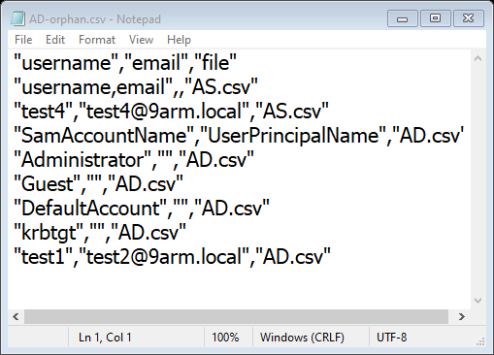
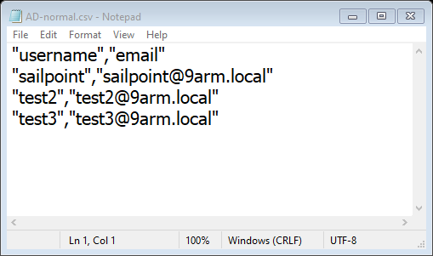
Compare Script will compare AS.csv and AD.csv will create 2 files 1 AD-normal.csv contain normal user 2 AD-orphan.csv contain orphan user (“File” indicate where username locate on AS or AD)

Slide 9
TO DO - Check user on orphan user
1 anyone using that account
- create new attribute call IGAexception
add reason for exception such as
- RPA
- Service account
- Share account
etc.
2 no one using that account
- delete account

